Slide 1

Title: SECUNET Chatbot Application
Subtitle: A Cybersecurity Awareness Chatbot
Name: Oladele Rakgolela
ST10449832

Slide 2
Introduction
Title: Introduction to SECUNET Chatbot
Content:
This is a simple chatbot application designed to assist users with cybersecurity awareness.
It uses speech synthesis to engage users and provides essential tips for online security.
The chatbot is part of a larger cybersecurity awareness program.

Slide 3
Application Overview
Title: Features of the SECUNET Chatbot
Content:
Speech Synthesis: The bot speaks to the user to improve engagement.
Voice Greeting: Plays an audio greeting if available.
Ascii Art Display: A fun way to introduce the bot using text art.
User Interaction: Ask the user to input their name and provide responses to various security topics.
Color-coded Console Output: Enhances the user experience with color-coded text.

Slide 4

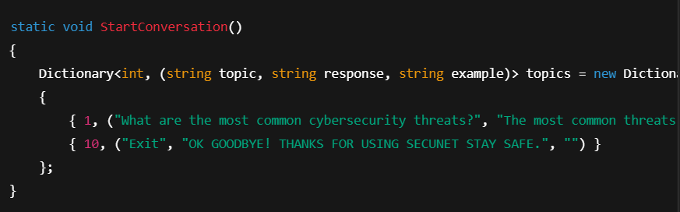
Main Code Structure
Overview of the Main Code
The program has several core parts:
Speech Synthesizer for voice interaction.
Main Menu where users choose a cybersecurity topic.
Help and Exit Options for user guidance.
The chatbot uses a dictionary of topics and responses to assist users
Code Snippet:

Slide 5
Color-coding and Visual Design
Title: Color-Coding in the Console Application
Content:
Cyan for Questions: User input prompts are in cyan to make them visually distinct.
White for Answers: Bot responses are displayed in white for clarity.
Ascii Art Colors: Adds a colorful introduction to the chatbot using multiple colors.

Slide 6
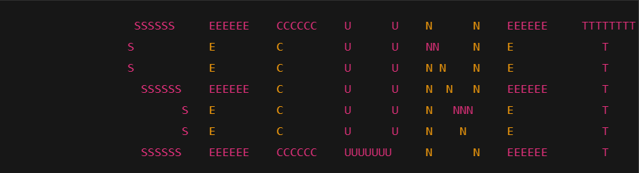
ASCII Art Logo
Content:
The program includes an ASCII art logo to greet the user.
The logo showcases the brand and adds personality to the chatbot.

Slide 7
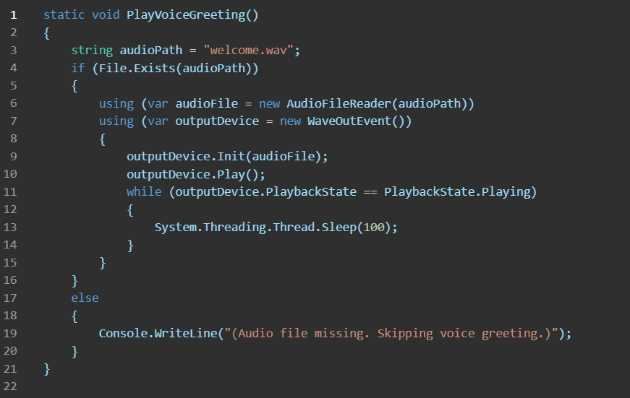
Voice Greeting Function
Play Voice Greeting
Content:
The bot plays a welcome message if the audio file exists.
Uses NAudio for playing WAV files and synchronizes the audio playback with a loop.

Slide 8
User Interaction Flow
Content:
Step 1: User enters their name.
Step 2: The bot asks if they need help (Yes/No).
Step 3: If Yes, the bot provides a list of cybersecurity topics.
Step 4: The user chooses a topic, and the bot provides a response and an example.
Step 5: The conversation can be exited at any time.

Slide 9
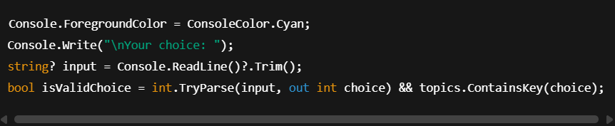
Code for Handling User Input
Title: Handling User Input
Content:
The chatbot validates user input to ensure correct choices are made.
A dictionary is used to store topics and corresponding responses.

Slide 10
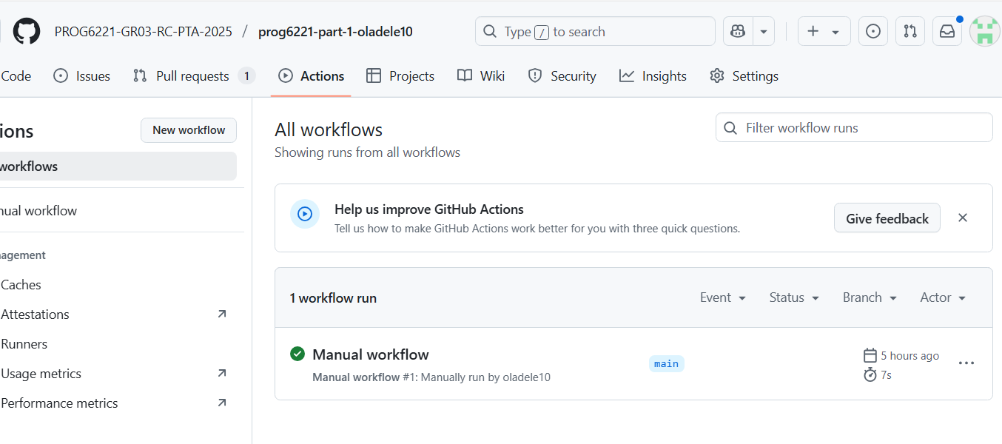
Workflow was triggered manually by me oladele10.
Executed on the main branch.
Workflow completed successfully ✅.
Execution time: 7 seconds.
Confirms the workflow was set up correctly.

Slide 11
The SECUNET Cybersecurity Chatbot is a console-based educational tool that promotes awareness of online safety by covering key cybersecurity topics such as phishing, data protection, and safe browsing. It uses speech synthesis, audio playback, and color-coded console outputs to make learning more interactive. Designed with strong programming principles like modularity and data structures, it’s effective for basic training in schools, communities, or businesses. While currently limited to static responses and a text-based interface, future improvements like a graphical user interface, real-time content updates, voice recognition, and gamified learning could significantly enhance its impact and usability. Overall, it’s a solid foundation for a scalable and engaging cybersecurity education tool.

